Slide 1

creating and sharing power bi reports

Slide 2
Introduction to Power BI
Overview of Power BI: Power BI is Microsoft’s suite of analytics tools for transforming raw data into visual reports and dashboards.
Why Power BI?:
Data Connectivity: Access data from multiple sources.
Data Transformation: Clean and shape data with Power Query.
Interactive Visualizations: Choose from a range of visuals to tell stories with data.
Collaboration: Share insights with ease.

Slide 3
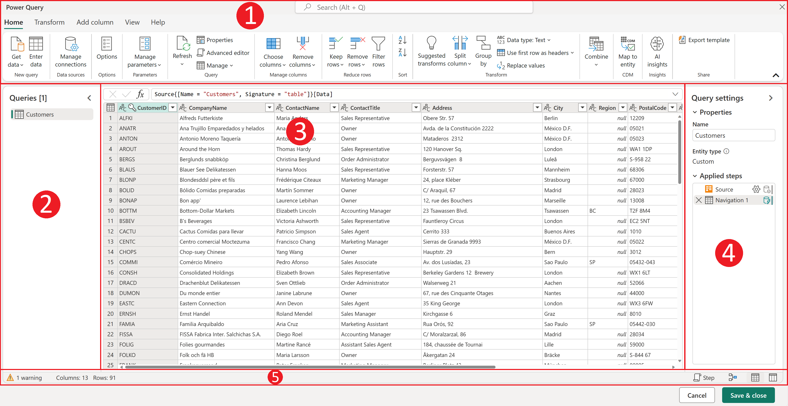
Step 1 – Data Import and Transformation
Importing Data:
Common Sources: File-based (Excel, CSV), databases (SQL, Oracle), online services (Azure, Salesforce), and custom APIs.
Connection Modes: Import Mode (stores data in Power BI), DirectQuery (connects directly to data source), Live Connection (real-time updates).
Using Power Query for Data Transformation:
Key Transformations: Removing duplicates, changing data types, filtering rows, renaming columns.
Data Shaping: Split columns, merge columns, pivot/unpivot data.

Slide 4
Step 2 – Data Modeling
Purpose of Data Modeling:
Define relationships between tables to enable accurate analysis.
Setting Up Relationships:
Types of Relationships: One-to-many, many-to-many.
Enforce Referential Integrity: Ensure data consistency by properly connecting related tables.
Creating Measures and Calculated Columns:
DAX (Data Analysis Expressions): Write formulas for calculations like SUM, AVERAGE, etc., which add new insights without changing source data.
Example: Calculated field for sales tax or profit margin.

Slide 5

Step 3 – Visualizing Data
Selecting the Right Visuals:
Visual Types: Bar charts for comparisons, line charts for trends, maps for geographic data, tables for granular details, and KPIs for targets.
Matching Visuals to Data: Choose visuals that best represent your insights.
Design Tips:
Use hierarchy (titles, labels) for clarity.
Limit the number of colors and avoid clutter to keep visuals readable.
Visual: Sample report with a few visual types (bar chart, line chart, map).

Slide 6
Step 4 – Adding Interactivity
Enhancing User Interaction:
Slicers: Filter data dynamically (e.g., filter by region or time period).
Drill-Throughs: Allow users to drill into more detailed information.
Bookmarks: Save views for specific use cases.
Using AI Features:
Key Influencers: Shows factors that impact specific outcomes.
Q&A Visual: Enables users to type questions and get visual answers.
Decomposition Tree: Analyzes data by breaking down metrics into component parts.

Slide 7
Step 5 – Publishing Power BI Reports
Publishing to Power BI Service:
Select Publish in Power BI Desktop and choose a workspace.
Importance of organizing reports in appropriate workspaces for collaboration.
Scheduling Data Refresh:
Set up scheduled refreshes for up-to-date reports.
Refresh Options: Frequency based on data type (daily, weekly, etc.).

Slide 8
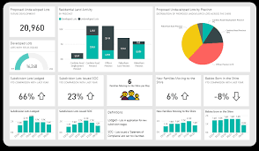
Step 6 – Creating Dashboards and Sharing Reports
Building Dashboards:
Pin key visuals from reports to create a high-level overview of KPIs.
Dashboard Purpose: Provides a snapshot of essential metrics in a single view.
Sharing Options:
Direct Links: Share report links with users, with options for access control.
Embedding: Embed reports in apps, websites, or internal portals.
Exporting: Export reports as PDF or PowerPoint for offline sharing.

Slide 9
Manage Permissions and Access Levels:
Set up role-based access for secure sharing.
Utilize Power BI Pro or Premium for sharing with external users.
Optimizing Performance:
Reduce data load by only importing necessary fields and tables.
Use aggregated measures rather than detailed columns.
Feedback and Iteration:
Gather user feedback for improvements and refine reports accordingly.
Best Practices for Sharing Power BI Reports

Slide 10
CONCLUSION
Power BI offers a powerful, all-in-one platform that transforms raw data into meaningful, interactive insights. By streamlining data import, cleaning, modeling, and visualization, it empowers users to create compelling reports that drive informed decisions. Power BI's advanced interactivity features and AI-driven insights allow users to dive deeper into data, while its seamless sharing options—such as dashboards, embedded links, and collaboration tools—make it easy to distribute insights across teams. With its robust capabilities, Power BI is an invaluable tool for anyone looking to unlock the full potential of their data, enabling continuous improvement and fostering a truly data-driven culture.

Slide 11

THANK YOU
thahliyamist@gmail.com

